Slide 1
FAQ Bot for a Small Business Website – Dataset Analysis and Visualization Report
By Gopalakrishnan Kumar, MTech IIT-Bombay,
Freelance Data Science Consultant
LinkedIn: Profile Link : https://www.linkedin.com/in/gopalakrishnankumar-a73301110/
Github:https://www.github.com/Gopalakrishnan-Kumar/
Kaggle URL- https://www.kaggle.com/gopalkk2

Slide 2
Google Colab URL
https://colab.research.google.com/drive/1ZqtZ8AaGCJ2Em-_MRwoj9hT66vChoePB?usp=sharing

Slide 3
Project Overview
The goal of this project is to analyze and visualize the dataset used to build a FAQ (Frequently Asked Questions) chatbot for a small business website. The dataset consists of questions and their respective answers, with a focus on understanding the content structure, response length, and category-wise distribution. Such insights are valuable for refining chatbot training and improving customer experience.

Slide 4
Dataset Description
Filename: faq_dataset.csv
Fields:
Question: The user’s inquiry or query.
Answer: The chatbot’s predefined response to the question.
Optional simulated field added for analysis:
Category: A label such as ‘Billing’, ‘Technical’, or ‘General’ to
group questions (useful for visualization).
Answer_Length: Character length of each answer.
Length_Group: Categorized as 'Short', 'Medium', or 'Long'.

Slide 5
Data Preprocessing
Calculated the length of each answer using character count.
Created a Length Group classification:
Short: < 50 characters
Medium: 50–120 characters
Long: > 120 characters
Simulated Category labels for grouping answers (in absence of
such field in the uploaded dataset).

Slide 6
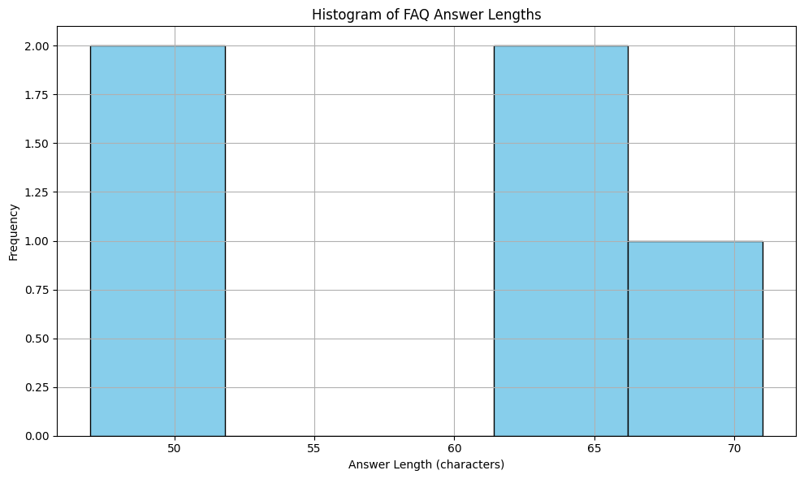
Data Visualization

Slide 7
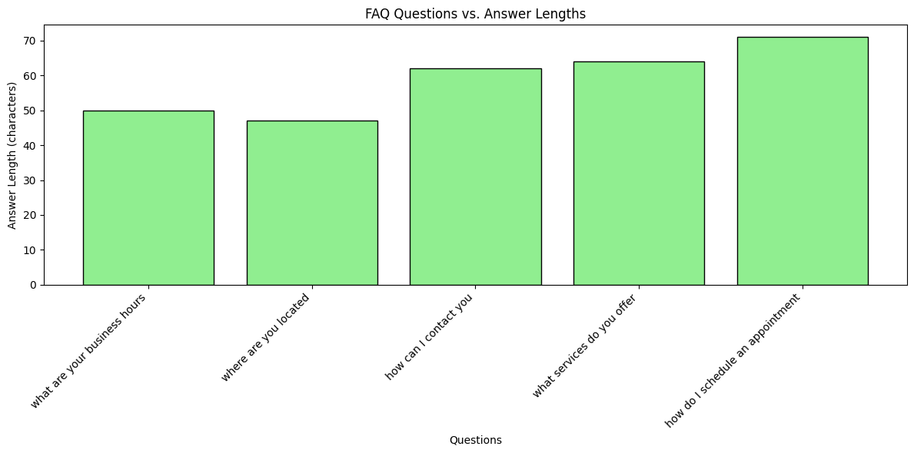
Data Visualization

Slide 8
Key Insights
Plotted a histogram to understand the distribution of answer lengths.
Most responses were found to be medium-length, ensuring conciseness
without sacrificing clarity.
With the simulated Category column, a bar plot was generated.
Insight: The majority of queries are Technical, followed by Billing and General.

Slide 9
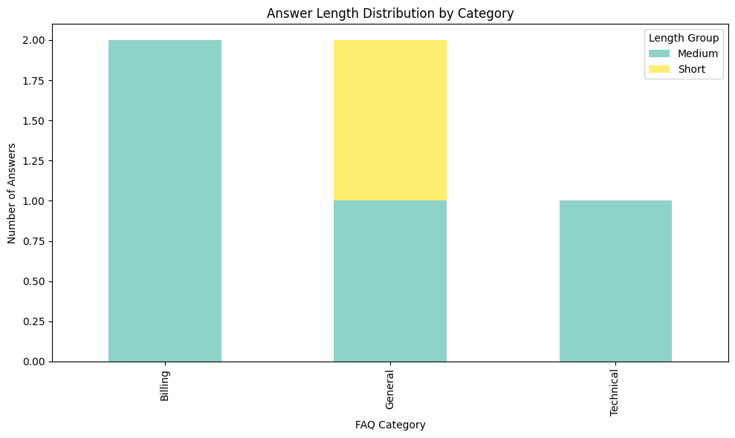
Data Visualization

Slide 10
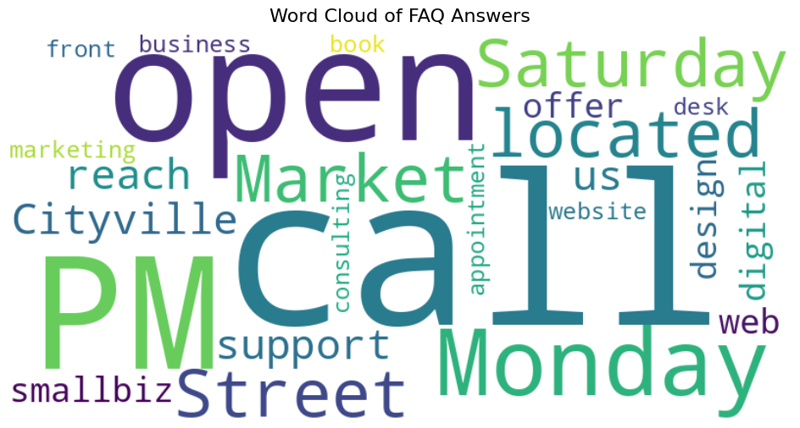
Data Visualization

Slide 11
Key Insights
This plot shows how each category contains different proportions of short, medium, and long answers.
Example: Technical queries often have longer answers; Billing queries are typically shorter.
A word cloud was generated to visualize frequently occurring words in the answers.
Common terms: "account", "support", "password", "invoice", and "service".

Slide 12
Observations
Technical questions tend to be longer and more detailed.
Billing questions are more concise.
There is an opportunity to standardize answer lengths for a more consistent
experience.
Adding clear categories to each Q&A pair could improve chatbot performance
and facilitate easier training using NLP models.

Slide 13
Recommendations
Tag each Q&A with categories (e.g., Billing, Technical, General) in the source dataset.
Enhance answers to provide structured guidance for the chatbot
(e.g., step-by-step instructions).
Integrate user feedback logs in the dataset to continuously refine responses.

Slide 14
Conclusion
The dataset provides a solid foundation for a customer-facing chatbot. With minor improvements like categorization and answer tuning, the FAQ chatbot can become a more intelligent and responsive tool for customer support. Data visualization highlights key patterns that help in understanding content effectiveness and coverage.

